Slide 1

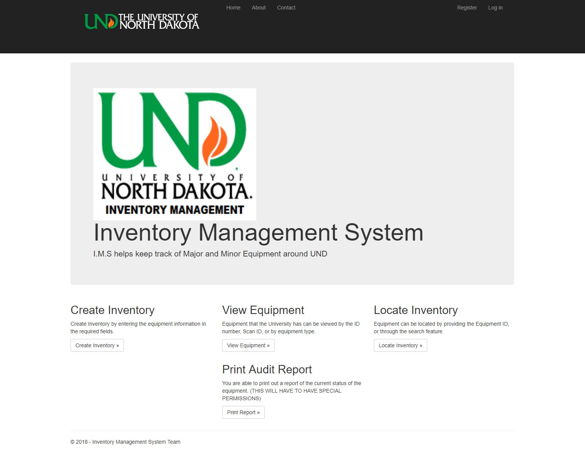
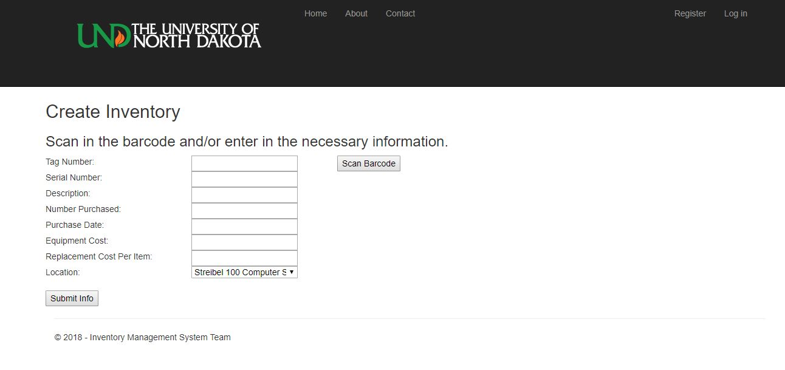
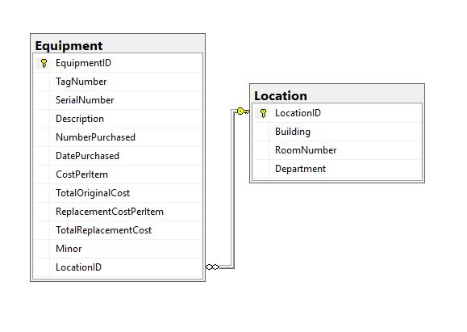
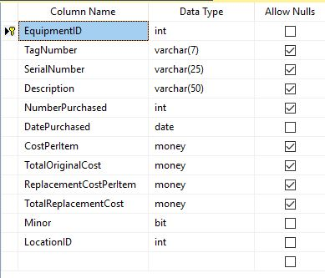
Developing A Web and Mobile Based Inventory Management System in ASP.NET/C# August Davis, David Erickson, Christian Hanson Advisor: Emanuel Grant
Spring 2018 Design Exposition
Abstract
University of North Dakota Computer Science department (UND CSCI) currently tracks its equipment through a Excel Spreadsheet type system. This can lead to accuracy and security errors. With the Inventory Management System (I.M.S), it provides an interface that is easy to use with functionality such as creating, viewing, and updating inventory. I.M.S utilizes a mobile phone’s camera to be able to scan barcodes that are already part of the current system.
Barcode Scanning
Android Scanning supported by external app “Barcode Scanner” by ZXing.
PC scanning is supported by a USB hand scanner
Interface
Designed using ASP.NET
Mobile compatible
Complies with most UND design standards
Allows for easy navigation
Diagram 3: Create inventory Page
Diagram 1: Home Page
Prepping for Future Development
README documentation is provided for detailed explanation to set up database and how the system works.
Source code pages have explanation headers and further explanation comments
Future work
Setting up a hosting server
Further optimizing the interface for mobile
Adjusting the interface to follow more UND standards
Converting the data from the old system to this one
Adding a scanning option for IOS
Adding updating and deleting of locations
Creating audit reports with Report Wizard tool
Backend Database
Microsoft SQL Server is used for storage of inventory and account information.
Diagram 4: Database Diagram
Diagram 5: Equipment Table

